Slide 1

Hands on with Hadoop
Naren Thilla, Kundan Chaulya
Apr 29th 2015
Hadoop Data Replication Techniques

Slide 2
Replication Process – Overall Scheme
Step 1: At time t0, copy the Base Data from the source. Let us call this table in HDFS as target_base.
Problem 1: The base table will always be off by the “drift” factor. Do not expose the base table directly.
Step 2: At time t1, determine the incremental data (aka the drift).
Option 1: Run a SQL query on the source to determine the drift.
Option 2: Run sqoop to determine the drift
Option 3: CDC based approach
Step 3: Extract the incremental data and copy it into HDFS as target_inc.
Step 4: Merge the incremental data with the base date. Create a view for the same.
Problem 1: This merge is an expensive operation.
Problem 2: Second, for every query into the view, the merge computation will be run.
Do not expose the view to end users.
Step 5: Materialize the view. Let us call it target_rpt.
Note: The materialized view will be accurate as of t1.
This will resolve problem 2 in Step 4.
Step 6: Drop the base table (target_base) and recreate from the materialized view (target_rpt).

Slide 3
Common Replication Tools
Batch and Micro Batch Replication:
Custom code using Sqoop (Oozie can be added for scheduling)
Real Time Replication (CDC Based Solutions)
HDFS Mount
Real Time Replication using Tungsten
Custom Code (TBD)
Data Bus from Linked in (http://data.linkedin.com/projects/databus)
FlexView (https://www.percona.com/blog/2011/03/23/using-flexviews-part-one-introduction-to-materialized-views/)

Slide 4
HDFSMount (optional)
Doing a HDFS Mount will allow you to copy files from windows or unix directory into HDFS as if it is a local copy.
This will also allow files (data ingestion) to be ingested directly from another host
For example, the ARLT .tpe files can be HDFSMounted. This will allow for direct loading of .TPE extactions into Hadoop
$ sudo apt-get install fuse
$ mkdir –p /mnt/hdfs
$ hadoop-fuse-dfs dfs://instance-1:8020 /mnt/hdfs
$ adduser cloudera <enter cloudera as the password>
Test file transfer
$ su cloudera
$ vi /home/cloudera/x <Enter some text and save it>
$ cp x /mnt/hdfs/user/cloudera
$ Verify if the file X exists in Hue

Slide 5
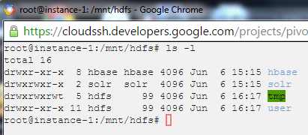
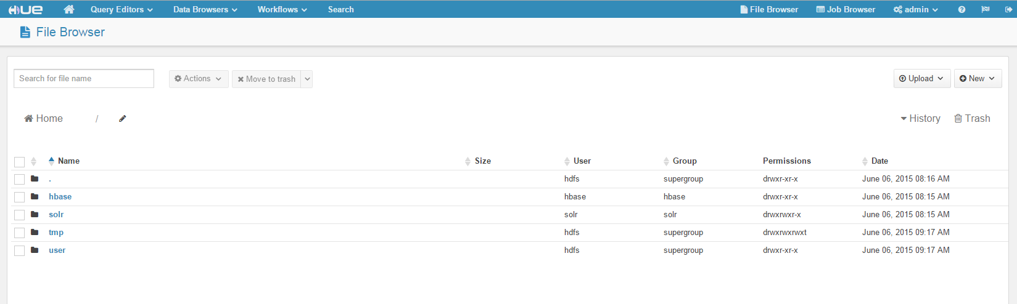
Verify the HDFS Mount via Hue
mkdir /mnt/hdfs
hadoop-fuse-dfs dfs://instance-1:8020 /mnt/hdfs
Copy files like a regular FS
$ cp /opt/downloads/*.txt /mnt/hdfs

Slide 6
Batch Replication using Sqoop
Run z:\....\code\sqoop\sqoop - incremental upload.sh

Slide 7
Understanding MySQL Binlogs
Enable binary logging : /etc/mysql/my.cnf
server-id = 1
log_bin = /var/log/mysql/mysql-bin.log
binlog_format=mixed <other options row/statement>
mysqlbinlog --database=sqoop --start-datetime="2015-06-10 15:20:00" mysql-bin.000005
https://www.percona.com/doc/percona-toolkit/2.2/pt-query-digest.html
https://dev.mysql.com/doc/refman/5.0/en/binary-log.html
https://dev.mysql.com/doc/refman/5.0/en/mysqlbinlog.html
mysqlbinlog mysql-bin.000008 | grep -i -e "^update" -e "^insert" -e "^delete" -e "^replace" -e "^alter" | cut -c1-100 | tr '[A-Z]' '[a-z]' | sed -e "s/\t/ /g;s/\`//g;s/(.*$//;s/ set .*$//;s/ as .*$//" | sed -e "s/ where .*$//" | sort | uniq -c | sort -nr | head -50

Slide 8
Real Time Data Ingestion –Tungsten
<Follow instructions mentioned in the Tungsten installation Guide - attached>

Slide 9
Real Time Data Ingestion – Custom Code
TBD

